Slide 1
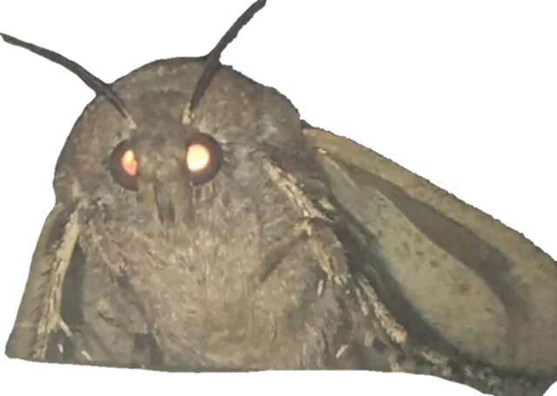
Moth-Eye Antireflection Nanostructures: Monte-Carlo Simulation
Alex Dufresne-Nappert, Matthew Athanasopoulos, Levi Brunelle
Notes:
.

Slide 2
Content we’ll be covering today
1. Background and Motivation
2. Methodology
3. Results and Discussion
4. Conclusions

Slide 3
01
Background and Motivation

Slide 4
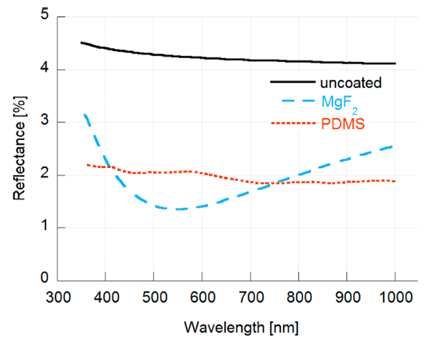
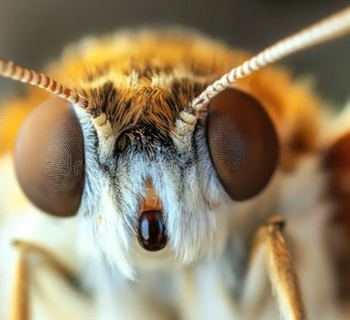
Motivation
Solar panels lose between 4-8% efficiency from Fresnel reflections on the glass surface.
Current antireflective coatings are lacking in many areas, mainly due their reliance on destructive interference.
Narrow chromatic range
Angle-sensitive
Solution: GRIN* antireflective film
Moth-Eye: biomimetic approach
Minimizes Reflection
Broadband Performance
Less angle-sensitive
*GRIN: Gradient Refractive INdex

Slide 5
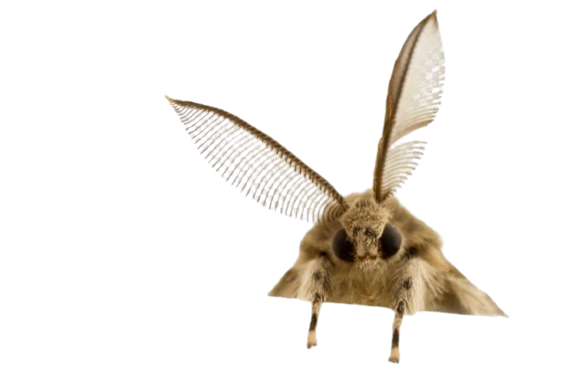
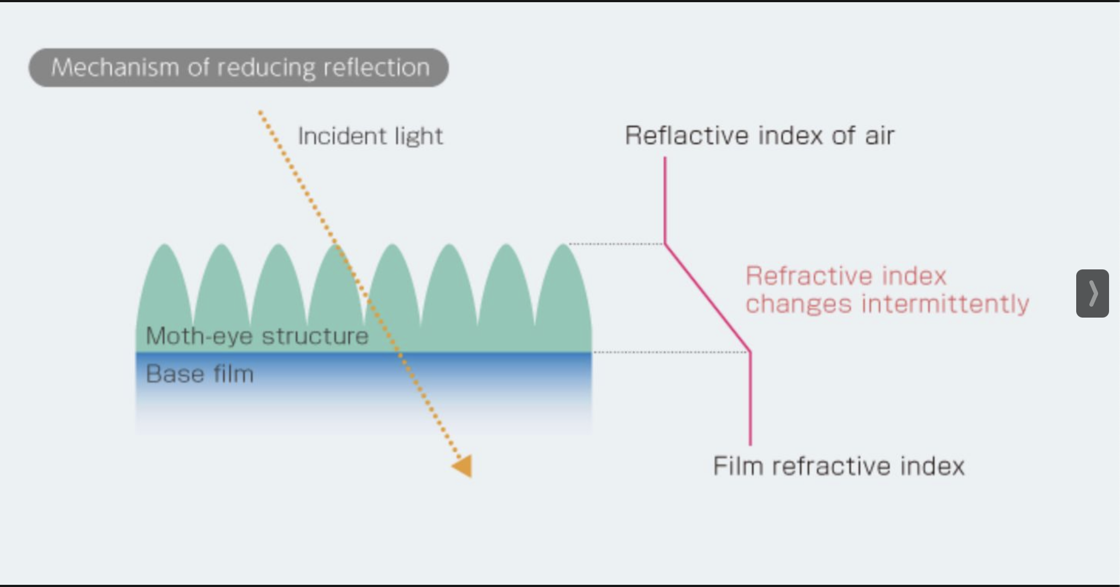
Background
Sharp index jumps at material interfaces cause Fresnel reflections
Moth-eye antireflective surfaces "ease" the light across the index boundary
Conical or hemispherical nanostructures create a gradual transition from (n=1) to (n=1.41) instead of sharp step
For our ray tracing simulation, we approximate the gradient with layers

Slide 6
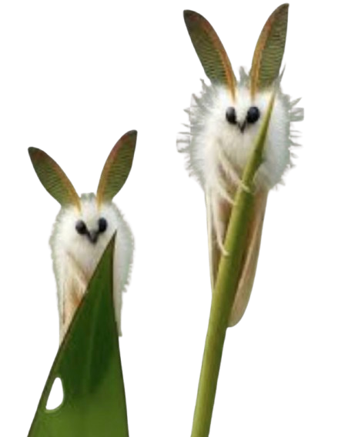
Objective
The goal of our research is to compare different simulation approaches for modeling the performance of a biomimetic “moth-eye” structure by building a Monte Carlo ray tracing engine and measuring transmittance, reflectance and absorbance of the films.

Slide 7
02
Methodology

Slide 8
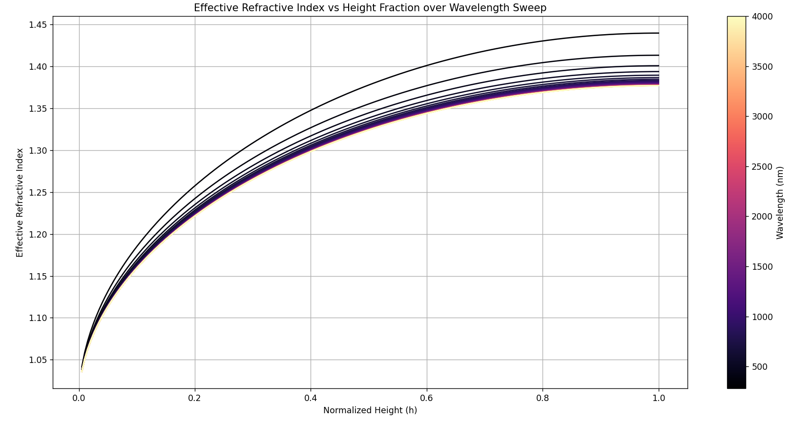
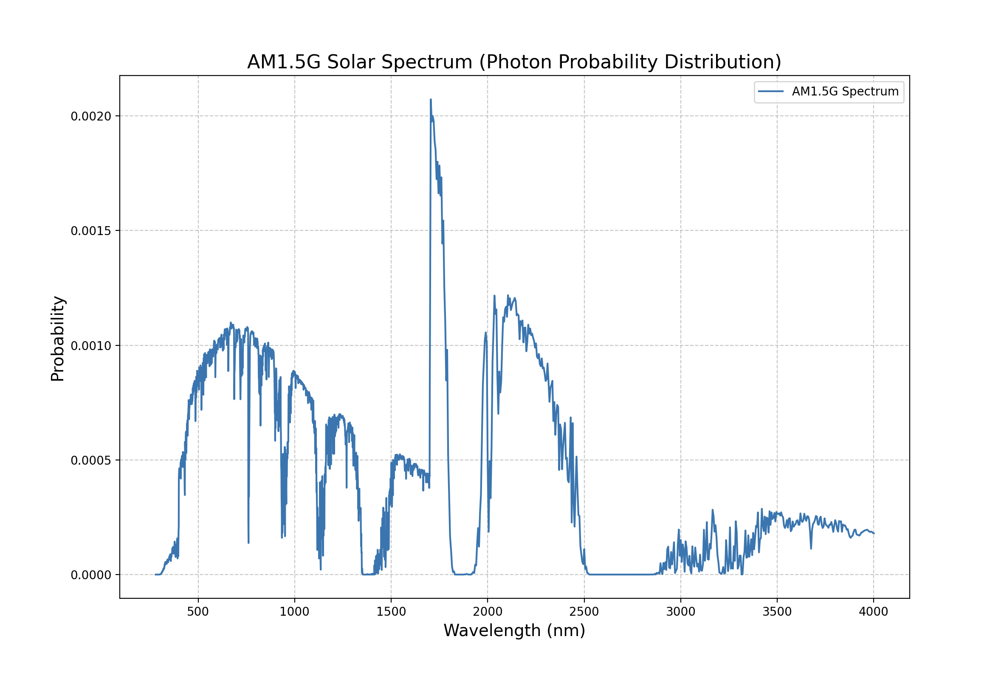
Methodology - Overview
Simulation Method: 2D Monte Carlo raytracing engine (C++)
Modeling approach
Add consecutive layers with small Δn, creating a graded index structure
Rays are probabilistically spawned based on photon density in the AM1.5G solar spectrum
We run 4 simulations
2 assume defect-free surfaces
2 assume surfaces with fractures/imperfections in surface
Sweep incident angles (𝚹), Number of Layers (n), Wavelengths (λ), Perturbance STD (𝛔)
Results averaged over 5 runs (N)

Slide 9
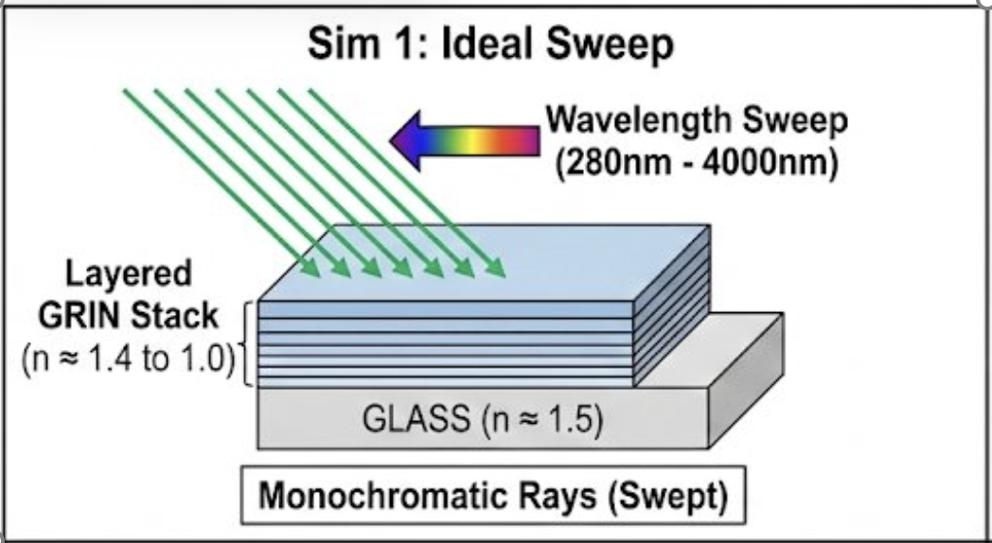
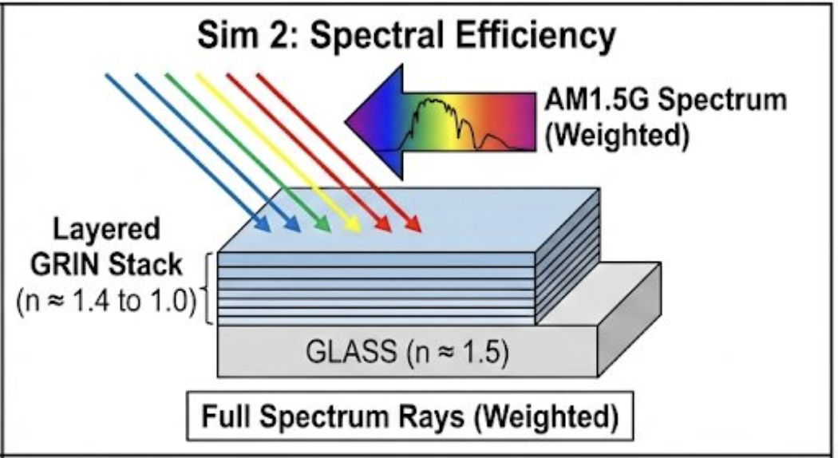
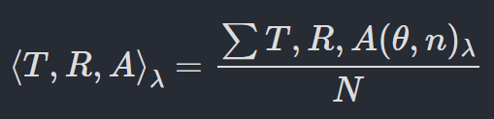
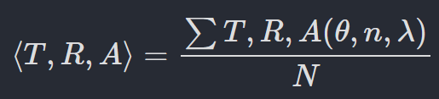
Methodology – Perfect surfaces
Simulation 1
We sweep across all wavelengths in spectrum on separate runs
Measure reflectance, absorption and transmission for each wavelength using
Simulation 2
Monte Carlo sampling from AM1.5G Spectrum
Average reflectance over multiple runs

Slide 10
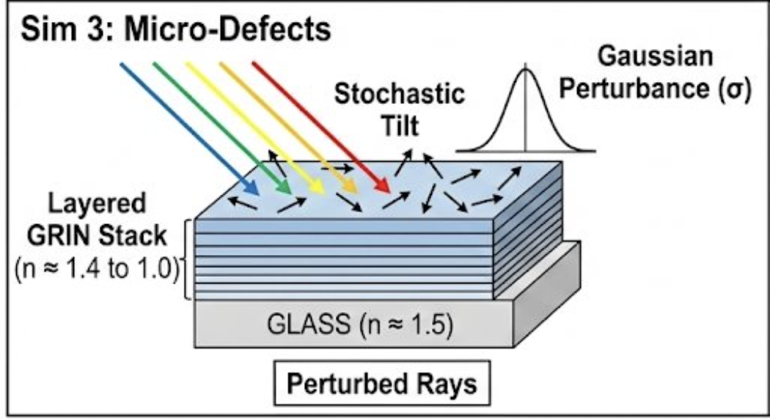
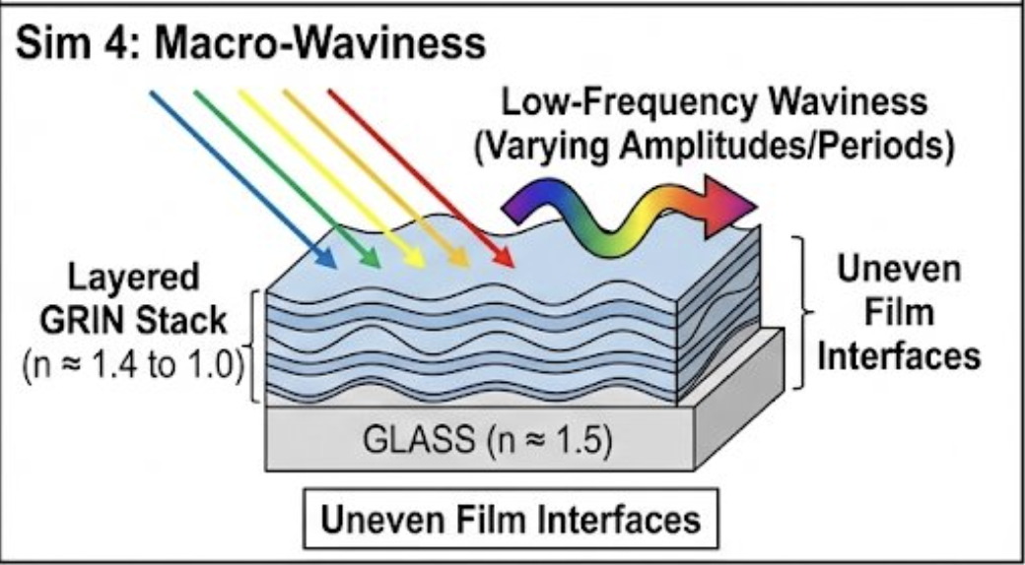
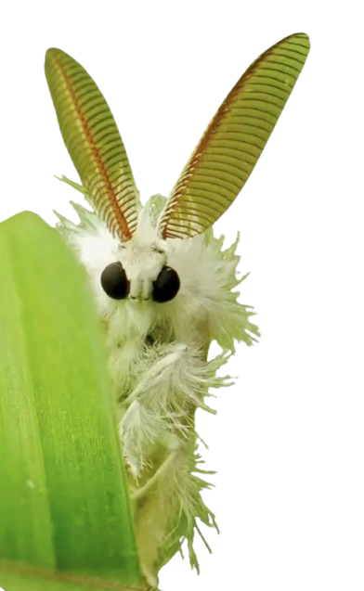
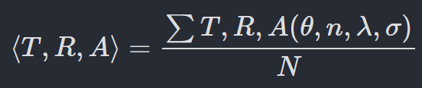
Methodology – Imperfect surfaces
Simulation 3
Uses Simulation 2 settings
Small surface defects
Small angles applied to surface segments
Surface normal defect angle is sampled from normal distribution
Simulation 4
Uses Simulation 3 settings
Large surface defects
Uses sine waves with large amplitude variation in the layers
Periods are sampled on a normal distribution

Slide 11
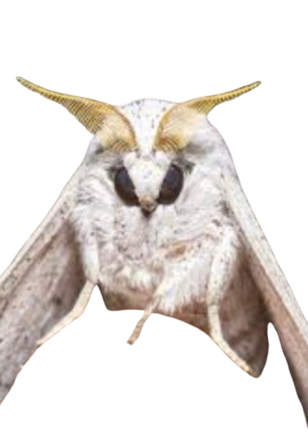
03
Results and discussion

Slide 12
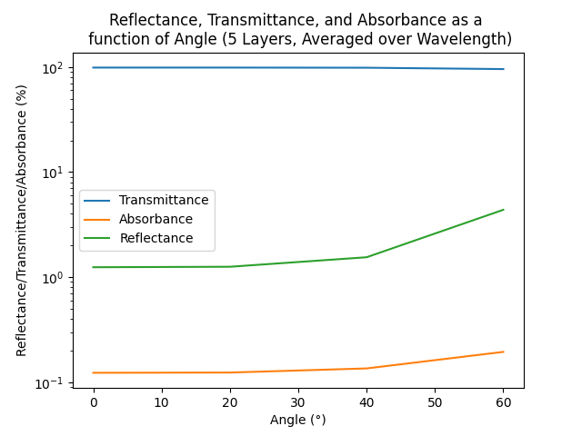
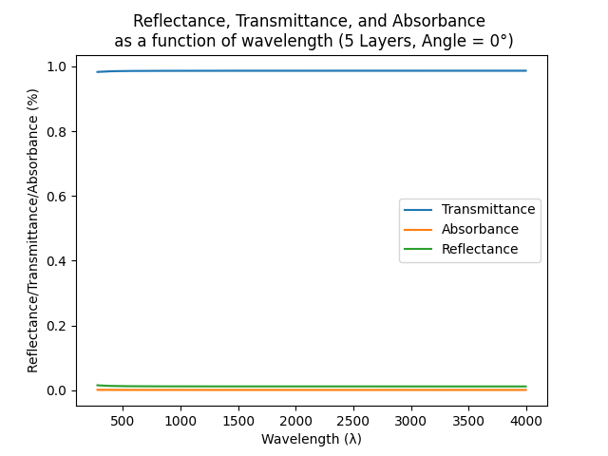
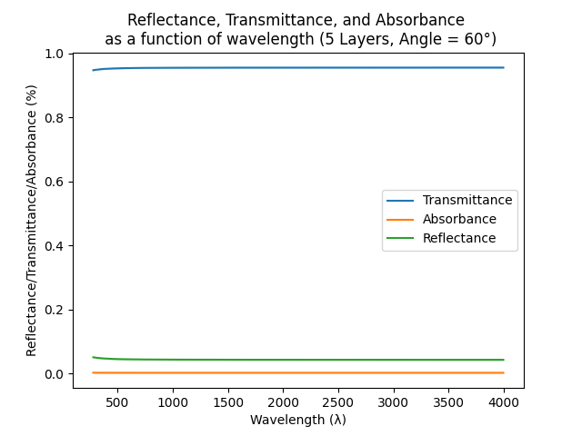
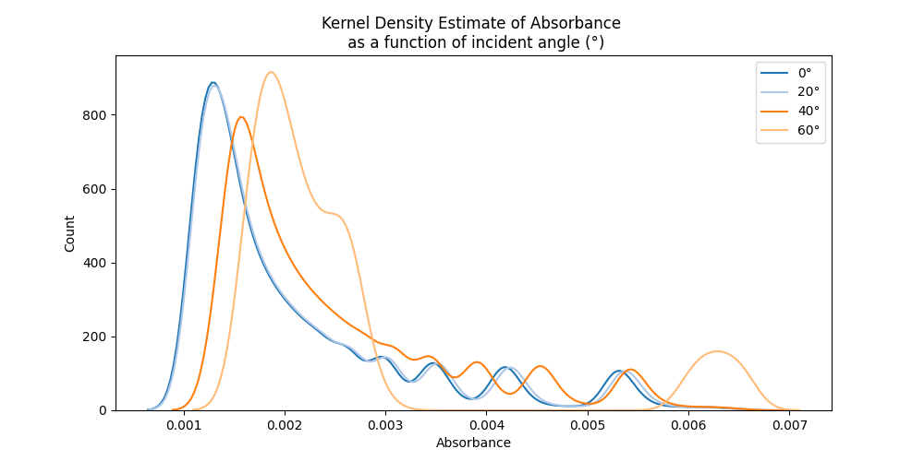
Simulation 1
High Transmittance over AM1.5G Spectrum
Reflectance and Absorbance Increase with angle
Absorbance is low but not 0
Peaks in KDE show discrete number of layers (n)
# Layers Increase

Slide 13
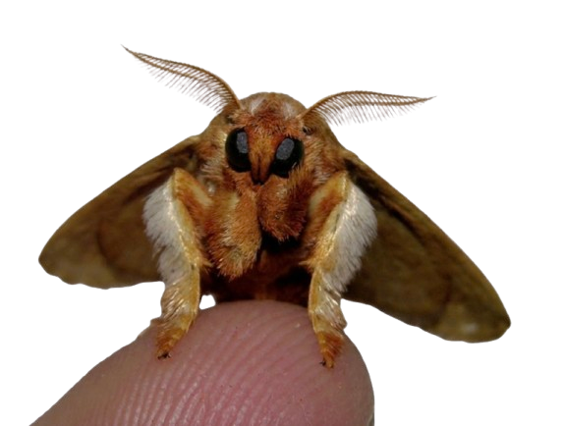
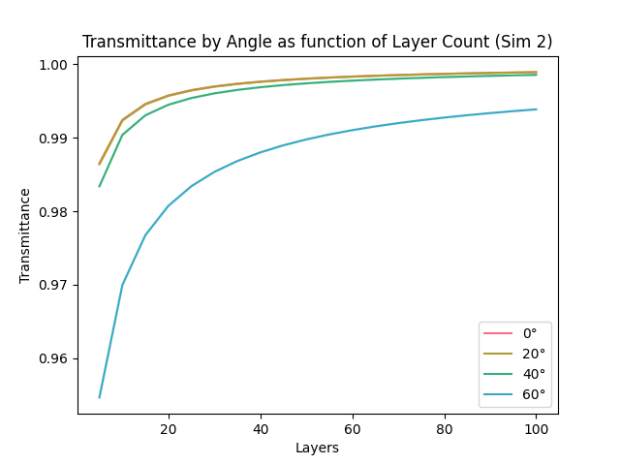
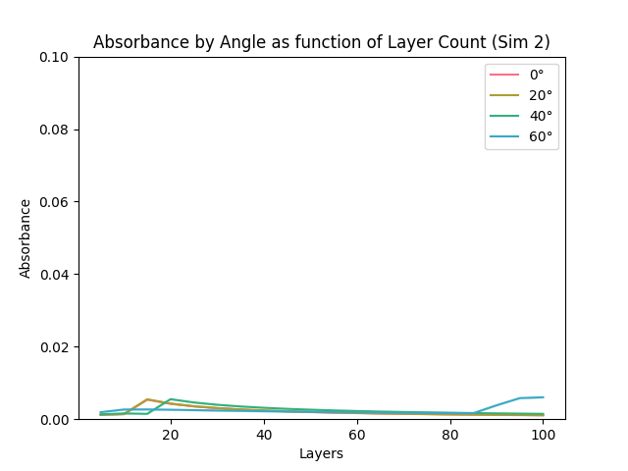
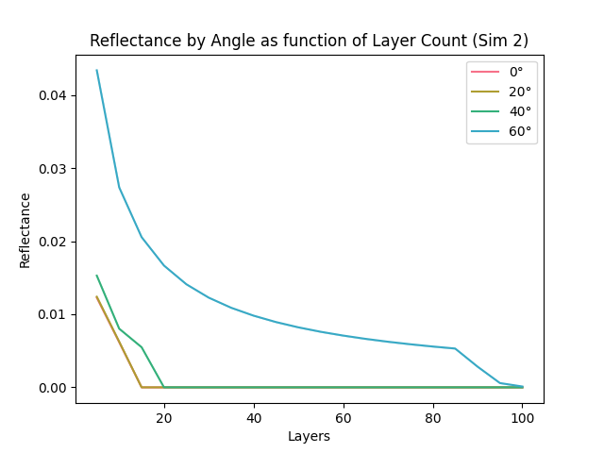
Simulation 2
As number of layers (n) increase
Reflectance lowers
Absorbance remains constant
Transmittance increases
As incident angle (𝚹) gets larger
Transmittance lowers
Reflectance increases
Absorbance remains constant
(%)

Slide 14
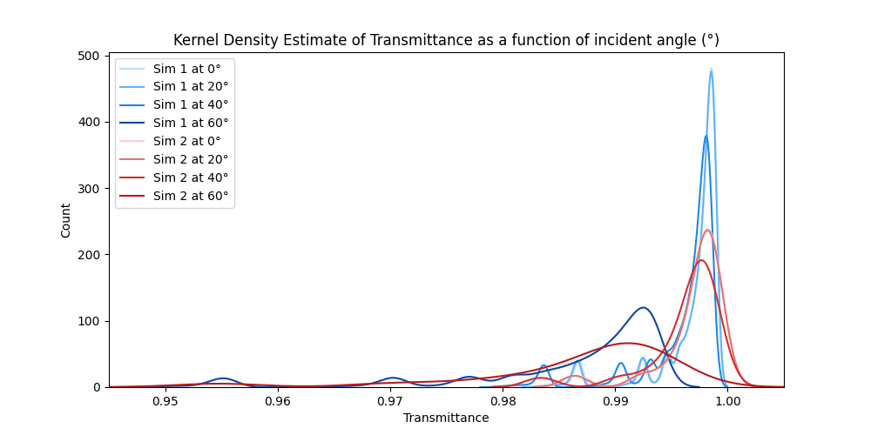
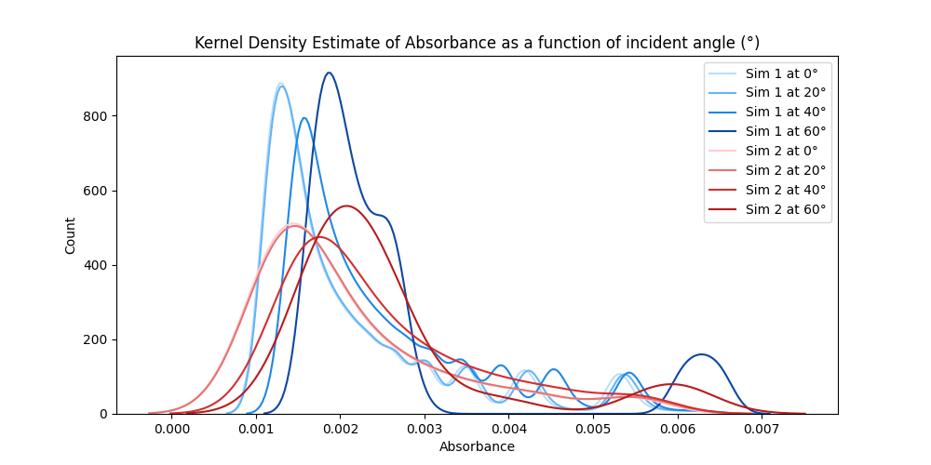
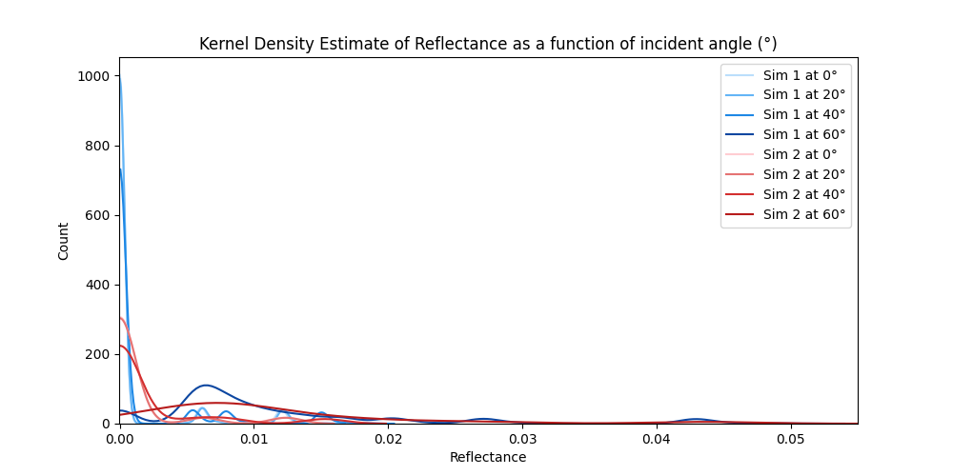
(Sim 1 – Sim 2) - Distributions
Comparing Sim 1 and 2
Peaks lower
Distributions broaden
This means :
AM1.5G sampling = larger T, R, A Var
Better Transmittance = More Layers
Layers
Layers
Layers

Slide 15
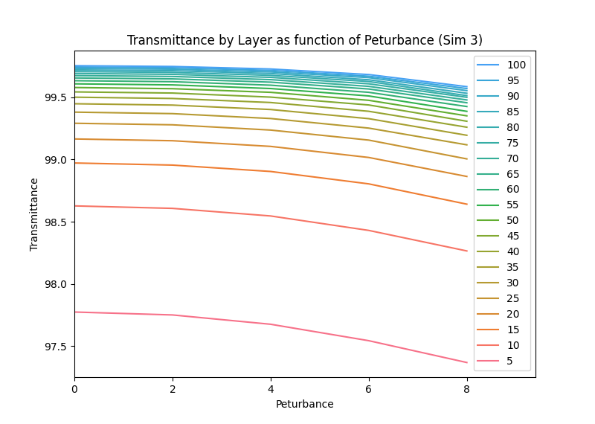
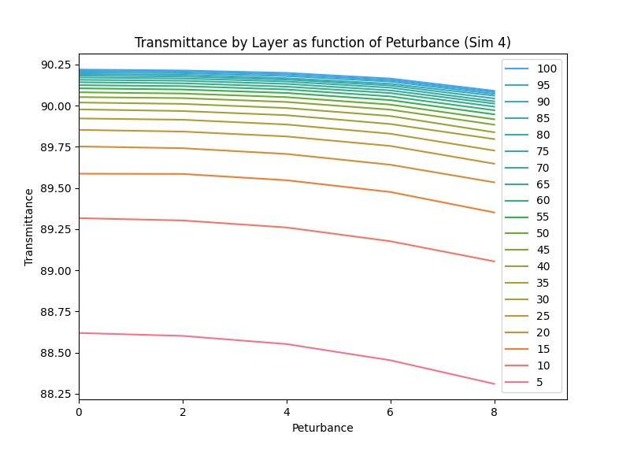
(Sim 3 – Sim 4)
(%)
(%)
Layers
Layers
Higher Perturbance = Lower Transmittance
Sim 4 Waviness decreases Transmittance
Increasing # of Sampled rays = Flatter curves
Sim 4 Wave amplitudes are too exaggerated

Slide 16
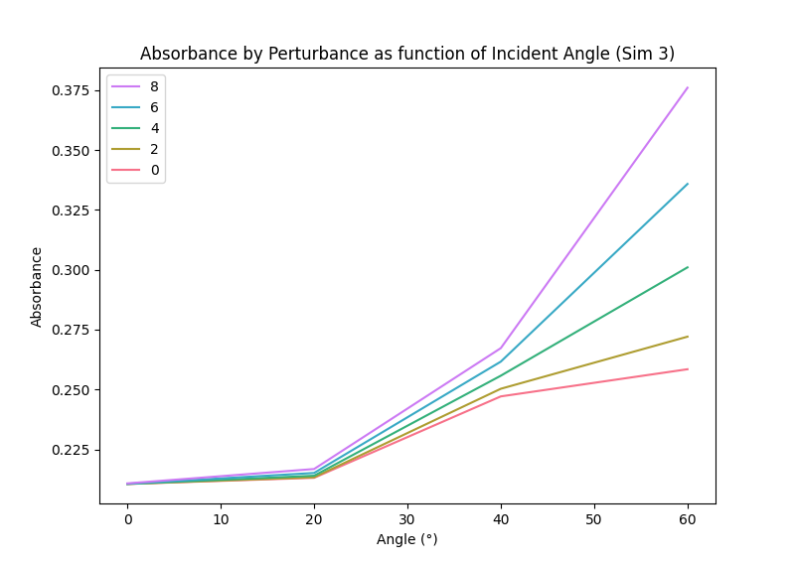
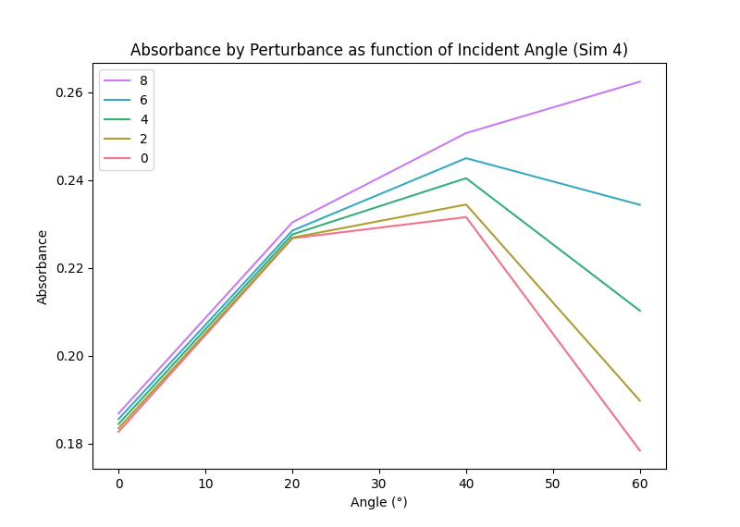
(Sim 3 – Sim 4)
(%)
(%)
Sim 3 Absorbance increases with
Incident Angle (𝚹)
Perturbance (𝛔)
Perturbance STD increases internal reflection
More layer defects = more internal reflection
Sim 4 Absorbance increases withs
Perturbance (𝛔)
Wavyness reduces absorption at high Angle and low Perturbance
Rays "ride" waves = more reflection

Slide 17
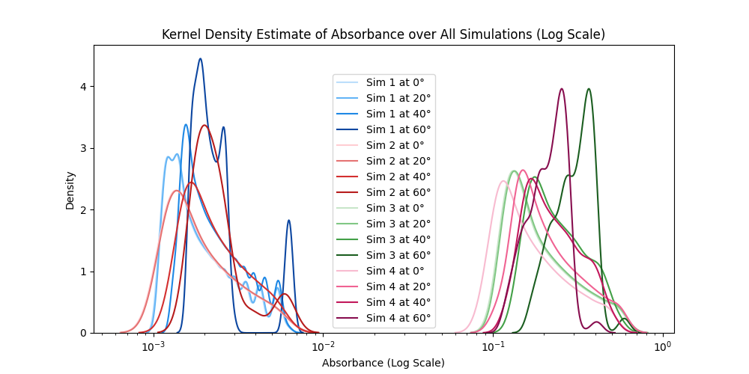
Normalized Absorption Density across Simulations
(%)

Slide 18
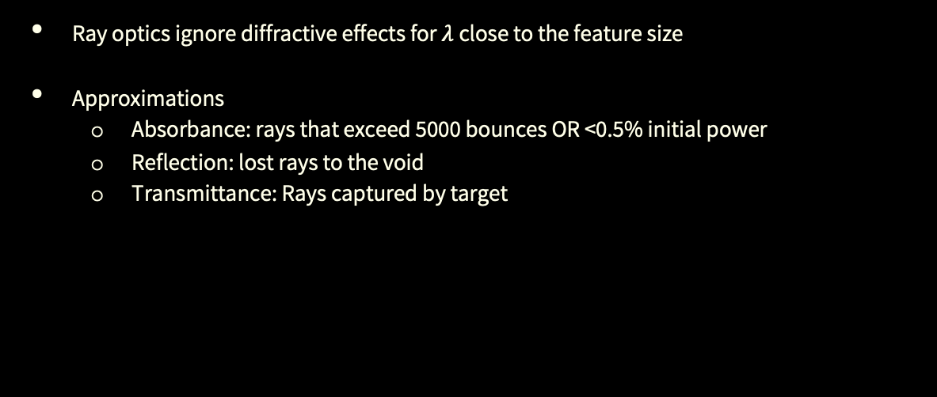
Limitations of this Approach
Ray optics ignore diffractive effects for $λ$close to the feature size
Approximations
Absorbance: rays that exceed 5000 bounces OR <0.5% initial power
Reflection: lost rays to the void
Transmittance: Rays captured by target

Slide 19
04
Concluding Remarks

Slide 20
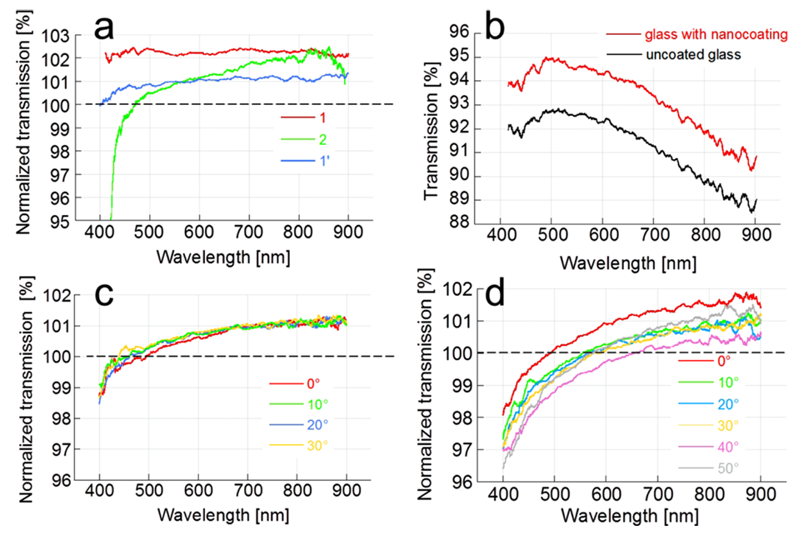
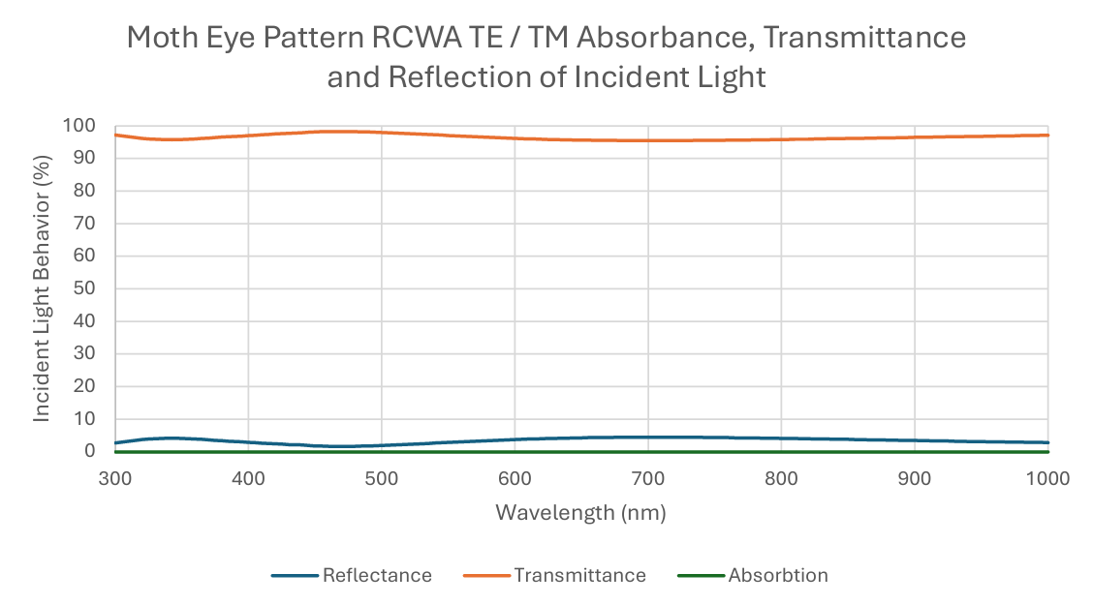
Concluding Remarks
Summary
Future Outlook
Simulations 1, 2, 3 accurately simulate T, R, A as modelled by RCWA (Rigorous Coupled Wave Analysis)
Simulation 4 performs worse than expected
Results are close to values reported in literature
Tuning values to match materials (Defect Samplings and Geometry)
Increasing # of Rays per simulation -> Larger samples from distributions
Further exploring trends and relations with larger dataset

Slide 21
Resource
Galeotti, F., Trespidi, F., Timo, G., & Pasini, M. (2014). Broadband and crack-free antireflection coatings by self-assembled moth eye patterns. ACS Applied Materials & Interfaces, 6(9), 5827–5834. https://doi.org/10.1021/am500687f
Raytracing Engine inspired by Sebastian Lague Videos on YouTube :
Coding Adventure: Ray Tracing Sebastian Lague. (2023, April 1). Coding Adventure: Ray Tracing [Video]. YouTube. https://www.youtube.com/watch?v=Qz0KTGYJtUk
Coding Adventure: More Ray Tracing! Sebastian Lague. (2024, June 12). Coding Adventure: More Ray Tracing! [Video]. YouTube. https://www.youtube.com/watch?v=C1H4zIiCOaI
GitHub to our Code for Simulations
https://github.com/MrDNAlex/NE-451-Final-Project-Raytracing

Slide 22
Thank you for listening! Q & A

